Slide 1
Diabetic Foot Ulcer Detection
A Deep Learning Journey with LIME Explanations in a Web App
__________
Supervised by -
Dr. Mohammad Monirujjaman Khan
Associate Professor,
North South University
CSE 498R. 04_________
Monirul Islam Mahmud - 2011839042
Mohammed Olid Ali Akash - 2011041642
Hafeza akter - 1922175042

Slide 2
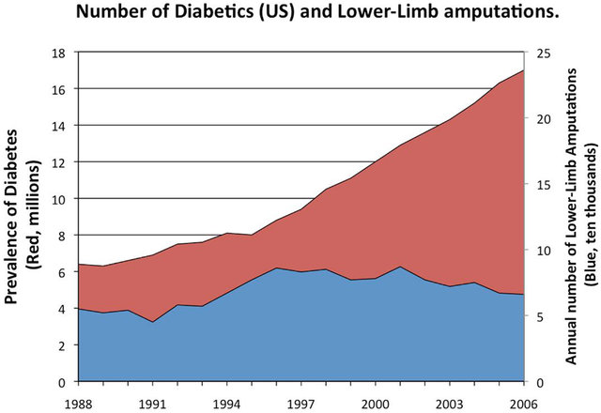
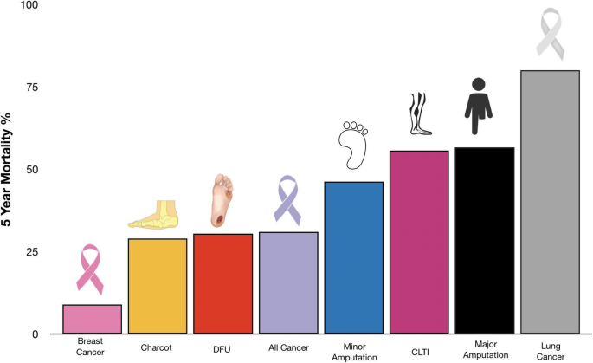
Motivation
https://www.researchgate.net/publication/248385280_The_Human_Cathelicidin_Antimicrobial_Peptide_LL-37_as_a_Potential_Treatment_for_Polymicrobial_Infected_Wounds
https://jfootankleres.biomedcentral.com/articles/10.1186/s13047-020-00383-2

Slide 3
Why this project?
Less work on the Foot ulcer merged dataset.
No previous work on DFU specific in Bangladesh!
Can easily collect foot images.
Less work on the explainability of the model.
There are fewer user-friendly web apps available for DFU.

Slide 4
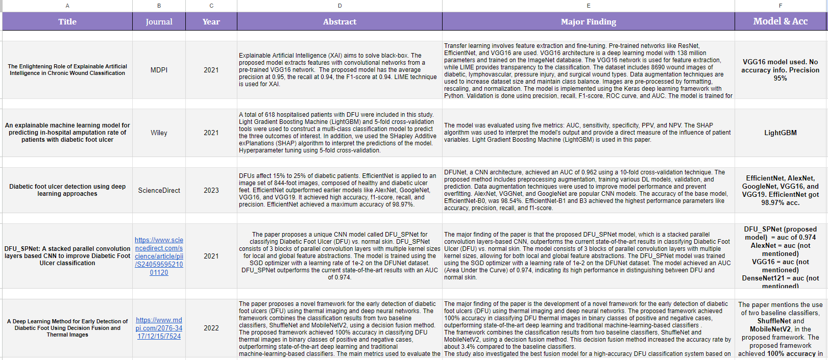
Related Works

Slide 5
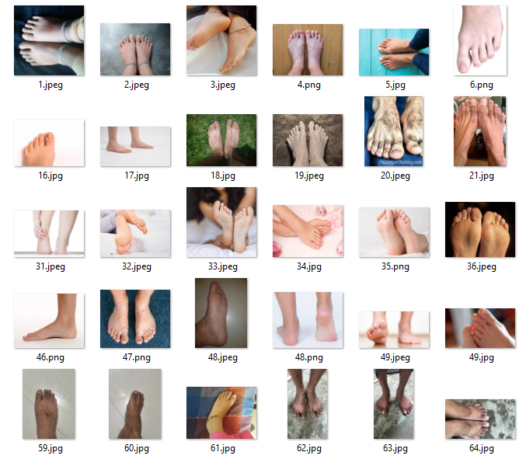
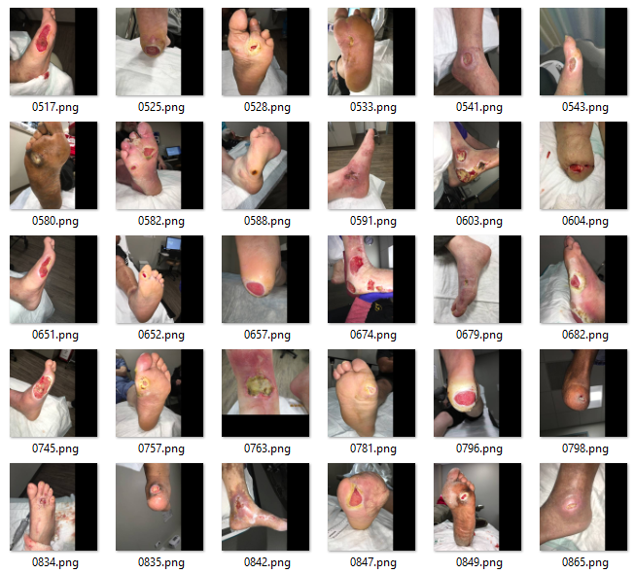
Dataset Details
Normal Foot
Foot Ulcer

Slide 6
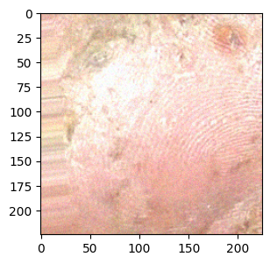
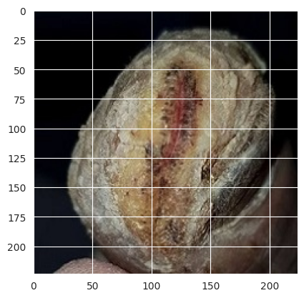
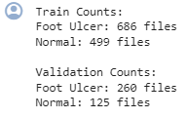
Data Preprocessing
Image size (255, 255)
Public Dataset -
Ulcer image - 712
Normal image - 543
Collected image -
Normal image - 100
Total = 1355 images

Slide 7
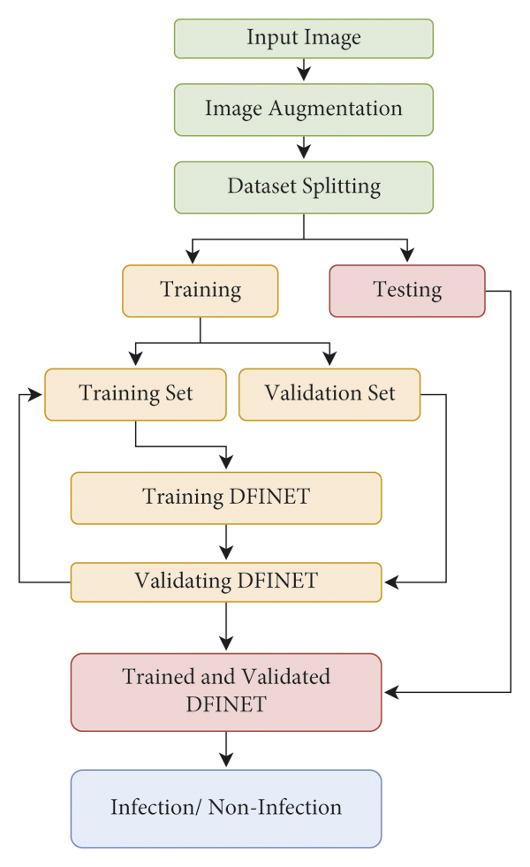
Methodology
Publicly Available + Collected Dataset
Deep Learning models
Validating models
Result Analysis
Explainable AI - LIME
Foot Ulcer / Normal
Web Application

Slide 8
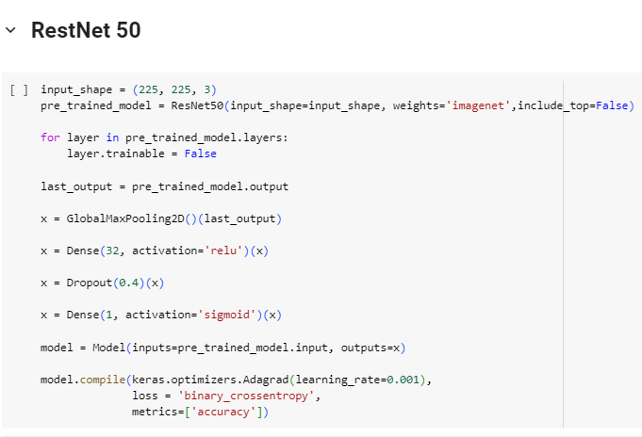
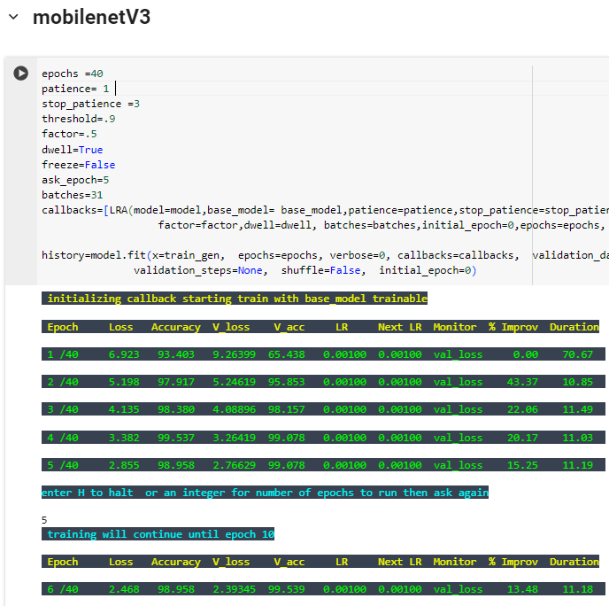
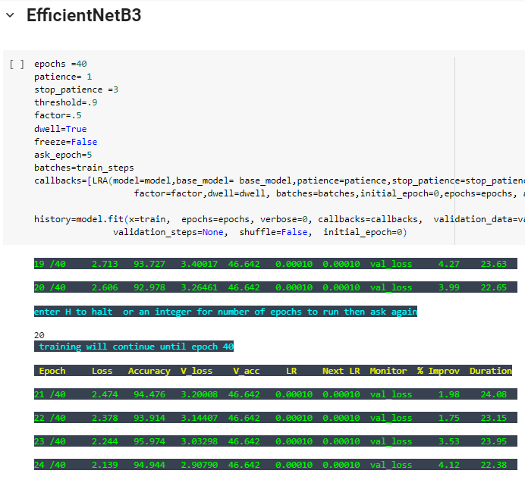
Model Applied
Accuracy - 56.73%
Training Accuracy - 100%
Testing Accuracy - 99.08%
Training Accuracy - 97%
Testing Accuracy - 46.64%

Slide 9
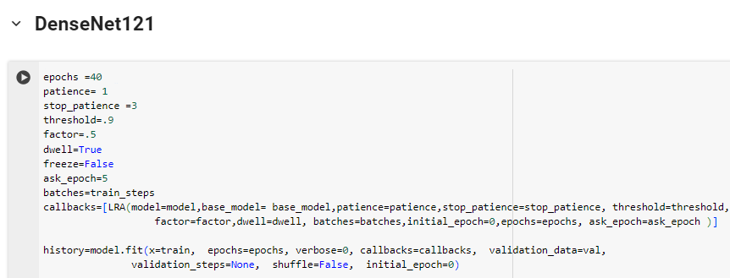
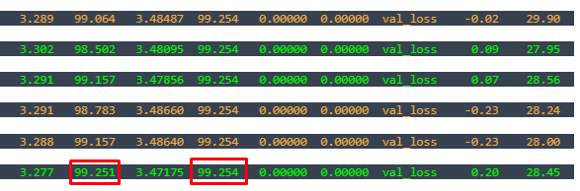
Best Model
Training Accuracy - 99.25%
Testing Accuracy - 99.25%

Slide 10
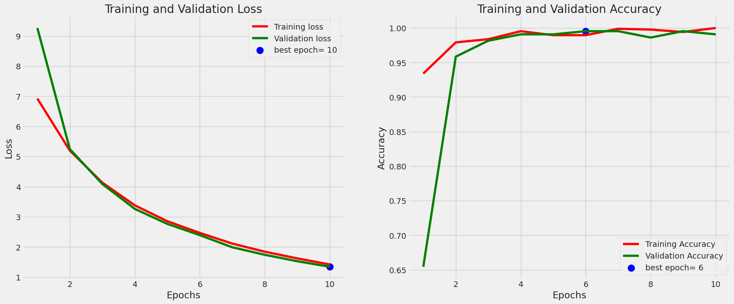
Result Analysis

Slide 11
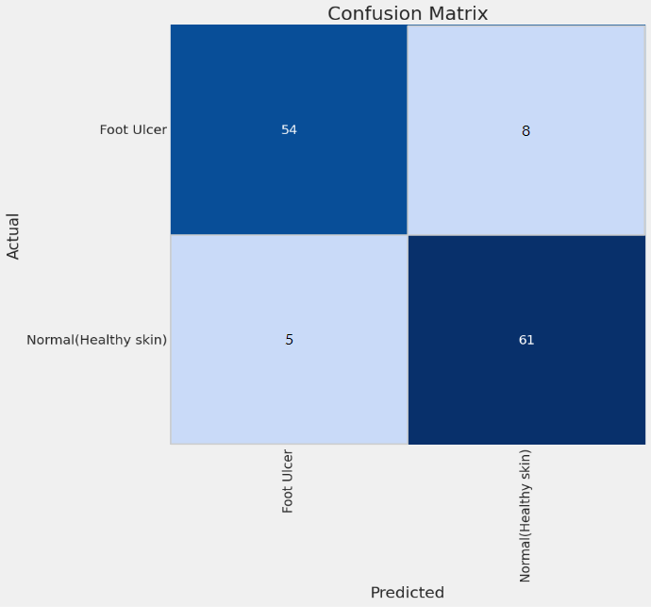
Confusion Matrix
DenseNet121

Slide 12
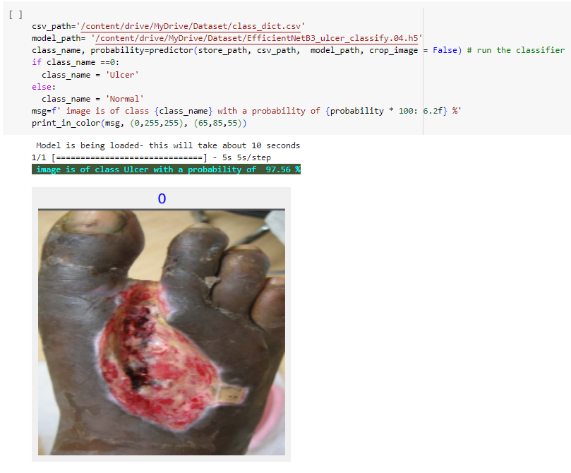
Checking Random image

Slide 13
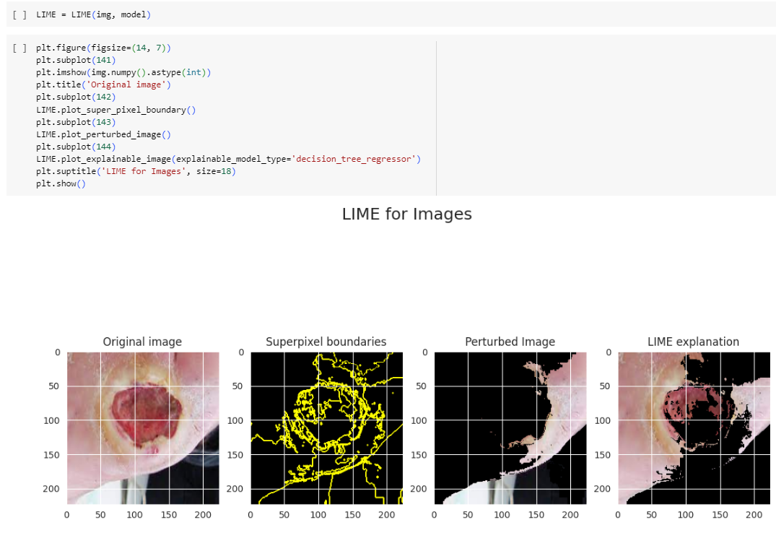
LIME

Slide 14
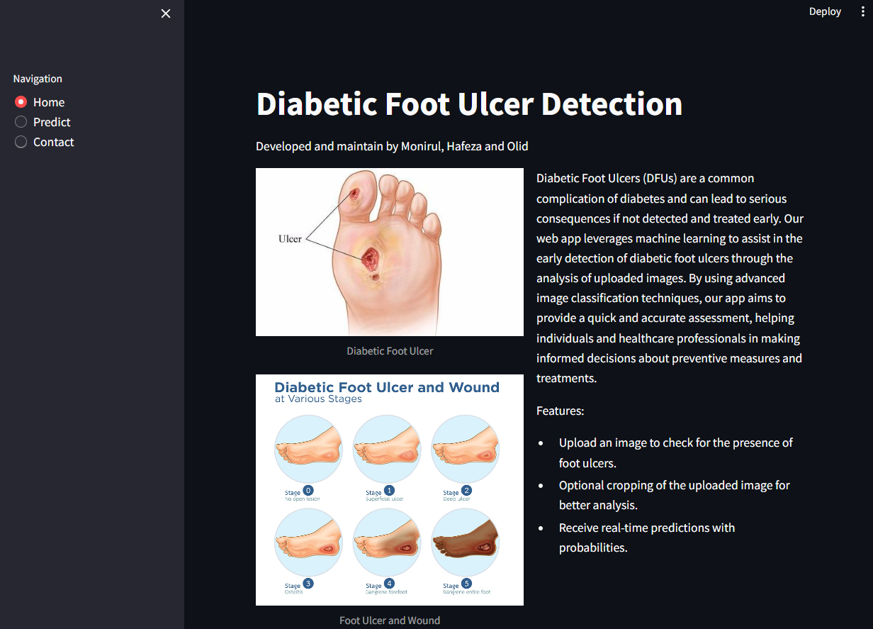
Live Webapp
Home Page
https://footulcer-bd.onrender.com

Slide 15
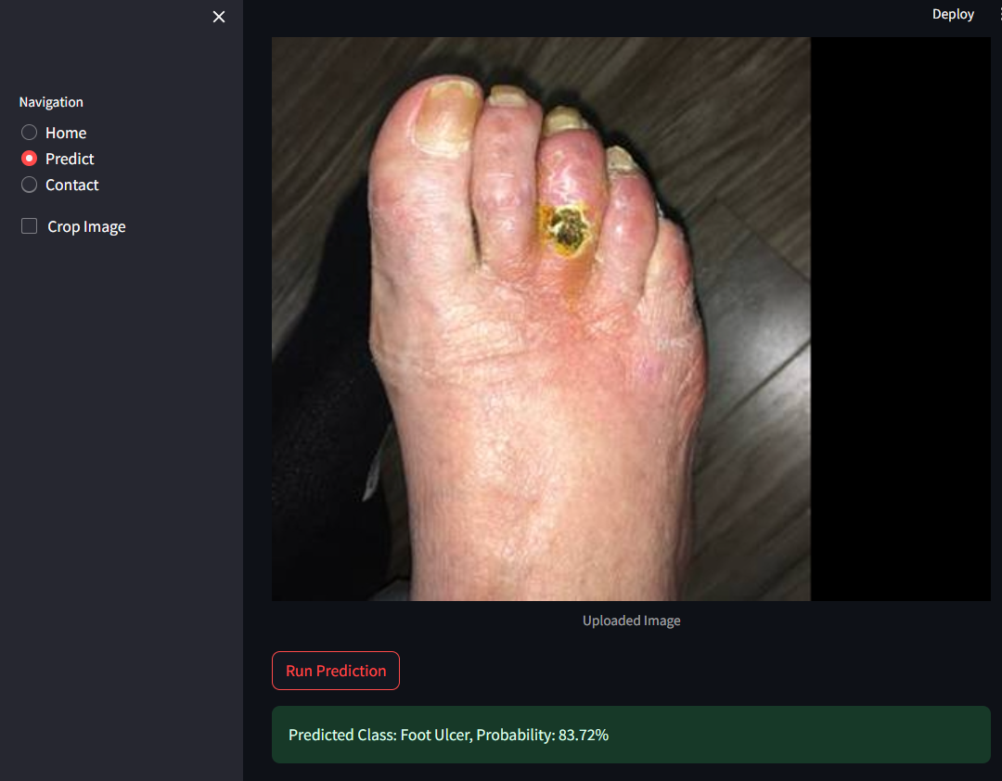
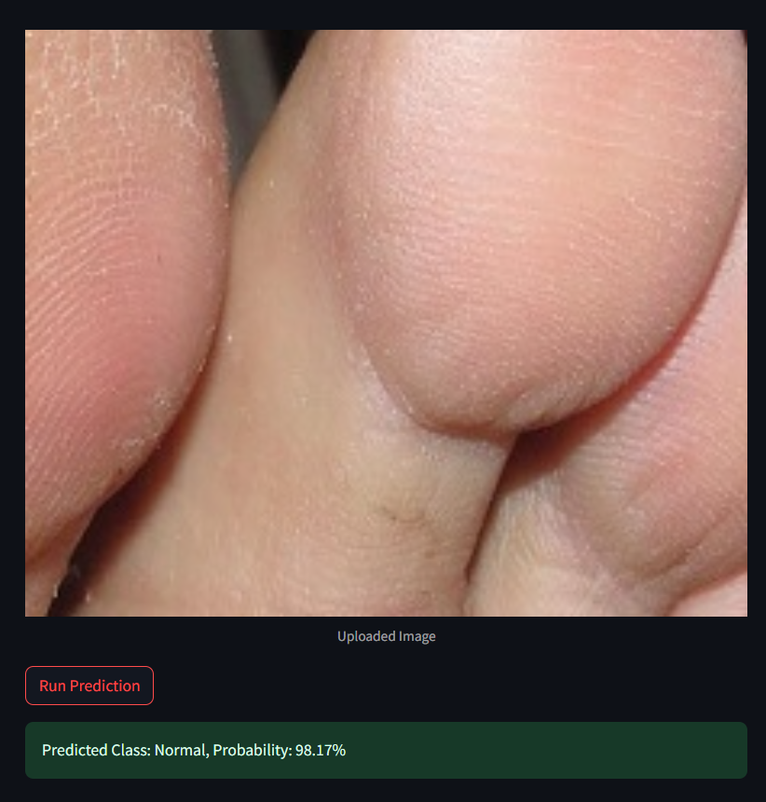
Prediction Page

Slide 16
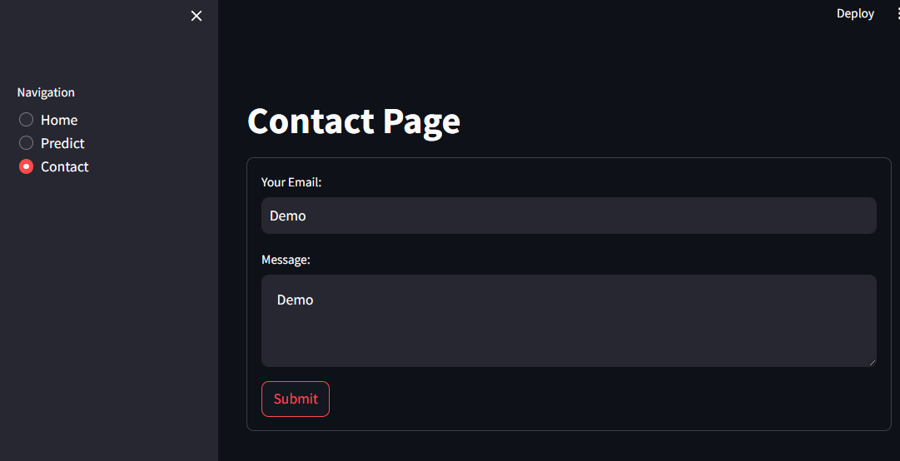
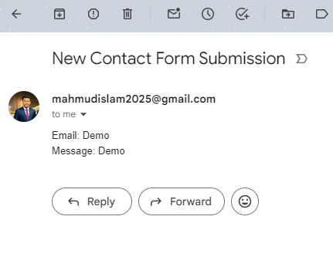
Contact Page

Slide 17
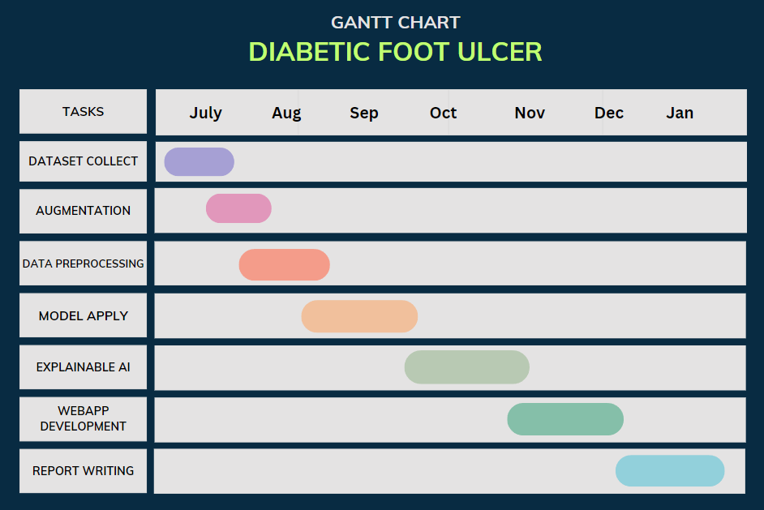
Gantt Chart

Slide 18
Future Work
Apply Hybrid Deep Learning Model: By combining cutting-edge technology with user-friendly applications, the project aligns with the broader goal of applying different deep learning model for early detection of diabetic foot ulcers.
User Friendly Website: Developing a web application for diabetic foot ulcer detection to empowers healthcare professionals with an accessible and intuitive tool.
Website with Cure: We will develop our webapp in a way that it can predict the Foot Ulcer as well as suggest some medicine and nearest best doctors based on the foot ulcer type.
Need for Explainability: In the context of healthcare, it is essential to ensure trust and understanding of the model predictions. Explainable AI, specifically SHAP, offers interpretable insights into the decision-making process of the deep learning models.
Less Research on Bangladesh Perspective: We can collect dataset from hospitals to continue research in Bangladesh Perspective.

Slide 19

Thank you!

